Slide 1
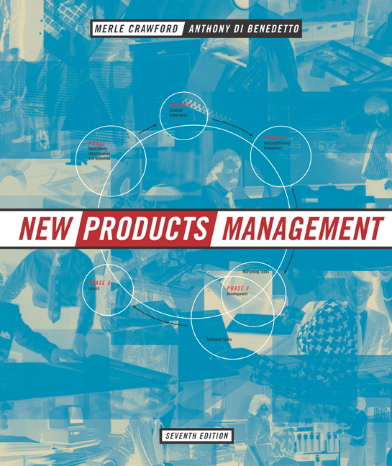
McGraw-Hill/Irwin
© 2003 The McGraw-Hill Companies, Inc., All Rights Reserved.

Slide 2
CHAPTER TWELVE
PRODUCT PROTOCOL

Slide 3
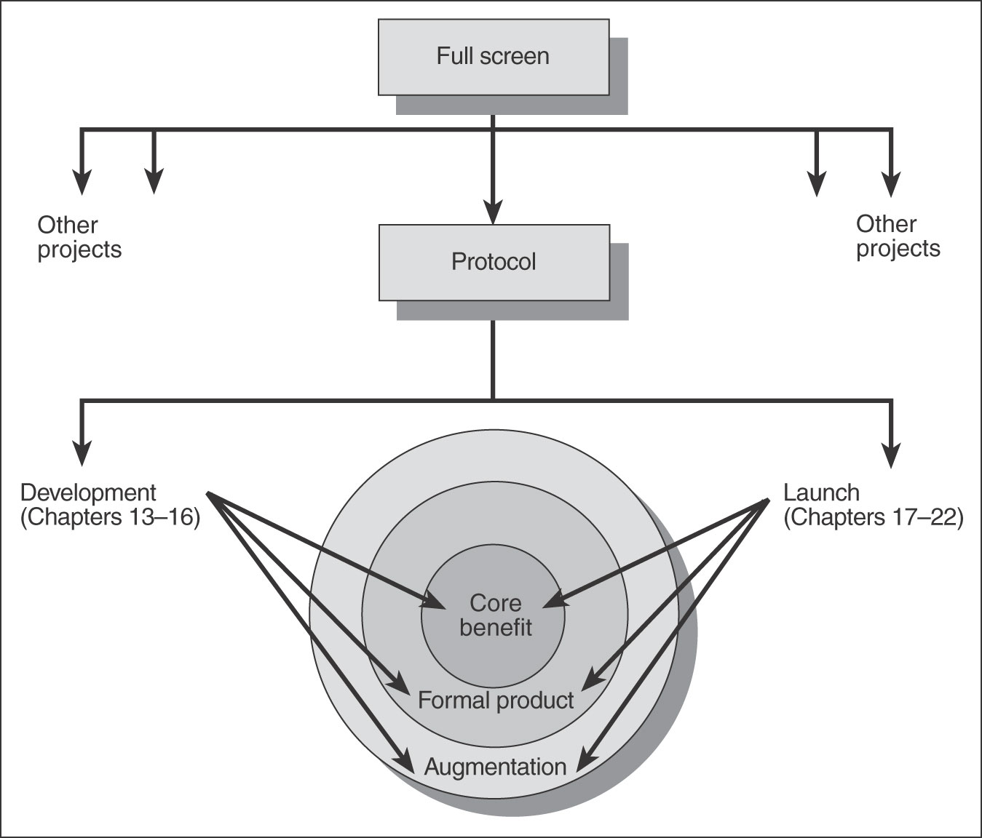
The Integrating and Focusing Role of Protocol
Figure 12.1

Slide 4
Why Have A Protocol?
Also known as product requirements, product definition, etc.
Doesn’t it seem obvious and simple?
Actually is one of the top success factors distinguishing winning from losing projects.
Maybe because it involves more than technical aspects.
POLITICS!!!

Slide 5
Purposes of Protocol
To determine what marketing and R&D need to do their work.
  More than a simple concept statement, yet less than we will have when the first prototype is available
  Identify key deliverables
To communicate essentials to all players and integrate their actions, assuring outcomes that are consistent with what was concept tested, screened and financially analyzed.
To set boundaries on development process and cut cycle time by clarifying measurable product and marketing requirements.
To permit the development process to be managed (i.e., what needs to be done, when, why, how, and by whom—and knowing whether we have met the objectives/requirements).

Slide 6
Contents of a Product Protocol
Target market
Product positioning
Product attributes (benefits)
Competitive comparison
Augmentation dimensions
Timing
Marketing requirements
Financial requirements
Production requirements
Regulatory requirements
Corporate strategy requirements
Potholes

Slide 7
Narrow Version of Protocol: End-User “I Want” List
This is the “I Want” list for a new lawn leaf blower /vacuum. These are benefits -- how they are achieved is determined during development.
Manufacturer stands behind product -- two year full warranty.
Electrically and mechanically safe. Good value and lasts a long time -- top quality component parts, state-of-the-art manufacturing.
Makes yard clean-up easier -- most powerful blower you can buy.
Converts from blower to vacuum without tools.
Electrical cord does not come loose.
Can be used with existing extension cord.
Easy to maneuver.
Clog-free vacuuming.
Tubes go together and stay together.

Slide 8
A Sample Protocol: Trash Disposal System
Figure 12-2
Must automate trash disposal at factory cost not to exceed $800.
Clean, ventilated, odor-free, no chance of combustion.
Must be safe enough to be operated by children; outside storage safeguards against children and animals.
Size must be small enough to work as kitchen appliance, to provide easy access and eliminate need for double handling of trash.
Simple installation
Decor adaptable to different user tastes.
If design requires opening of exterior walls, structural integrity and insulation against elements must be maintained.
User-friendly, automatic operation, easy to maintain by technical servicepeople.

Slide 9
Quality Function Deployment (QFD)
A technique designed to insure that customer needs are focused on throughout the new product project.
First step is the House of Quality (HOQ): gathers desired attributes from customers and translates them to engineering characteristics.
Requires inputs from marketing and technical personnel; encourages communication and cooperation across the functional areas.

Slide 10
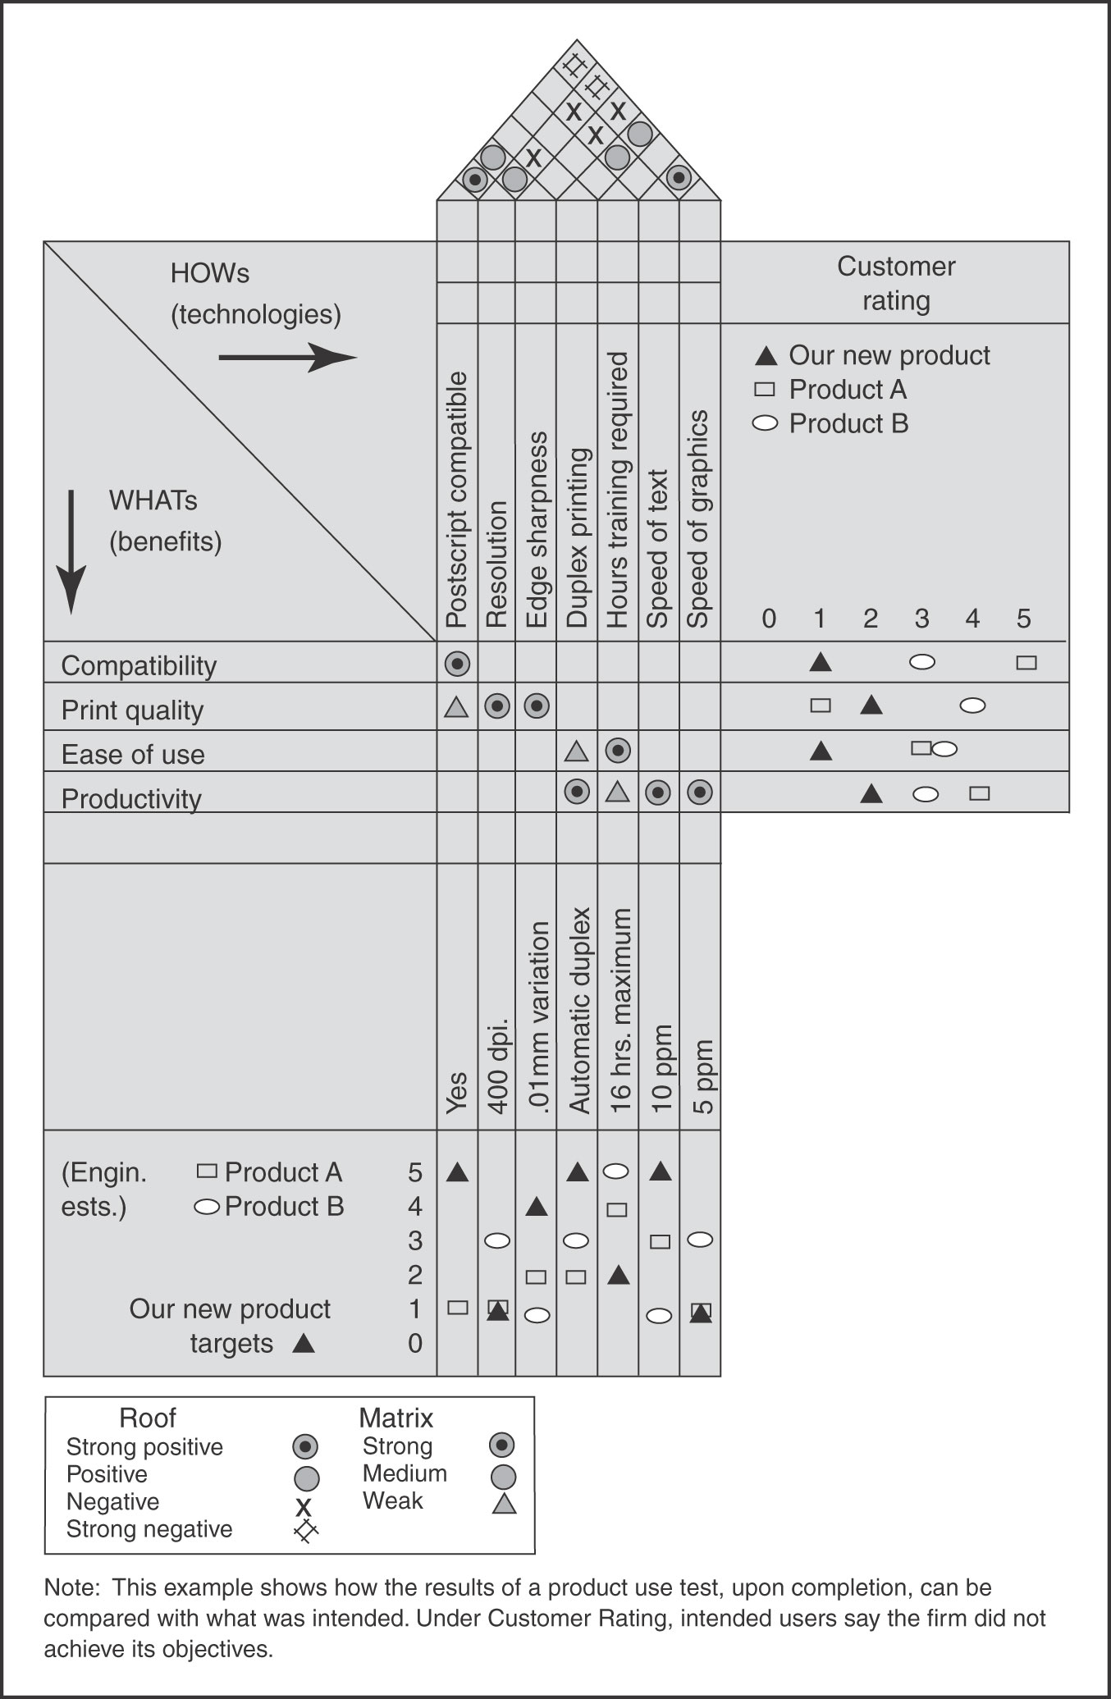
QFD and Its House of Quality
Figure 12.3

Slide 11
Benefits in QFD Example
Compatibility
Print quality
Ease of use
Productivity

Slide 12
Technologies in QFD Example
Postscript compatible
Resolution
Edge sharpness
Duplex printing
Hours training required
Speed (text)
Speed (graphics)

Slide 13
Tradeoffs in QFD Example
Improving resolution slows down text printing and really slows down graphics printing.
Increasing edge sharpness slows down both text and graphics printing.
Duplex printing speeds up text and graphics printing.
Postscript compatibility improves resolution and edge sharpness.

Slide 14
Moving to Later Stages of QFD
Figure 12.4
House of Quality:
Customer Attributes
Engineering Characteristics
Converted to:
Parts Deployment:
Engineering Characteristics
Parts Characteristics
Converted to:
Process Planning:
Parts Characteristics
Process Operations
Converted to:
Production Planning:
Process Operations
Production Requirements
Converted to:
Source: Adapted from John R. Hauser and Don Clausing, “The House of Quality,” Harvard Business Review, May-June, 1988.

Slide 15
QFD Realities
Substantial cost and time commitment.
Only mixed results in some applications.
Requires top management support and commitment.
Must be viewed internally as an investment.
Requires good functional integration.
May work better if the team members have a successful track record of working together before—and if they use QFD consistently.

